Slide 1
DATA ANALYSIS AND VISUALIZATION
20PITC57J
Session – 7
Data Preprocessing Techniques
Missing Value Imputation

Slide 2
Agenda
Imputing missing values in categorical variables
Machine Learning based imputation strategies
Machine Learning Imputation Methods
Comparing the characteristics of data before and after imputing
Data Transformations: Need of transforming data
Types of transformation techniques

Slide 3
Data Scaling
Data scaling refers to the process of changing the range of values or dimensions of variables within a dataset while maintaining their proportions.
It's a fundamental step in data preprocessing used to standardize or normalize the features or variables in a dataset.
The main purpose of data scaling is to ensure that the numerical variables or features are on a similar scale, preventing one feature from dominating or affecting others disproportionately during analysis.
It helps in improving the performance and training speed of machine learning algorithms.
There are two common methods for data scaling:
Normalization (Min-Max Scaling)
This technique rescales the data into a fixed range, usually between 0 and 1.
It is achieved by subtracting the minimum value from each observation and dividing by the range of the variable.

Slide 4
Data Scaling
Standardization (Z-score Normalization):
Standardization transforms the data to have a mean of 0 and a standard deviation of 1.
This method is less affected by outliers and is generally preferred when the data is normally distributed.
Scaling is particularly important for algorithms that use distance-based calculations, such as k-Nearest Neighbors (KNN) or clustering, as these algorithms are sensitive to the scale of the variables.
In summary, data scaling ensures that the variables are in a consistent range, making them more manageable and allowing models to interpret and learn from the data more effectively.
The choice between normalization and standardization depends on the distribution and characteristics of the data, as well as the specific requirements of the machine learning algorithm being used.

Slide 5
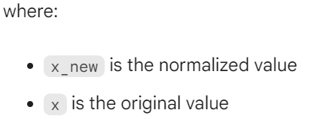
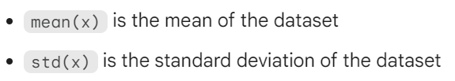
Data Standardization Vs Normalization
Data standardization and data normalization are two similar but distinct data preprocessing techniques used in machine learning.
Both techniques involve transforming the data to a new scale, but they do so in different ways.
Data standardization scales the data so that it has a mean of 0 and a standard deviation of 1.
This is done by subtracting the mean from each data point and then dividing by the standard deviation.
The formula for z-score normalization is as follows:

Slide 6

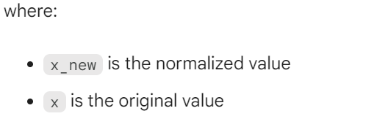

Data Standardization Vs Normalization
Data normalization scales the data so that it falls within a specific range, such as 0 to 1 or -1 to 1.
This can be done using a variety of methods, such as min-max scaling, z-score scaling, or decimal scaling.
The formula for min-max scaling is as follows:
Which technique to use depends on the specific machine learning algorithm being used.
Some algorithms, such as support vector machines and k-nearest neighbors, are sensitive to the scale of the data, and standardization can improve their performance.

Slide 7
Data Standardization Vs Normalization
Feature | Data Standardization | Data Normalization
Scales the data to have a mean of 0 and a standard deviation of 1 | Yes | No
Scales the data to fall within a specific range | No | Yes
Sensitive to outliers | Less sensitive | More sensitive
Can improve the performance of machine learning algorithms | Yes | Yes, but not as much as data standardization

Slide 8
Data Standardization Vs Normalization
When you can use data standardization or data normalization.
Data standardization: You are using a support vector machine or k-nearest neighbors algorithm to classify your data.
Data normalization: You are using a decision tree or random forest algorithm to classify your data.
Data standardization: You are using a neural network to predict a continuous value, such as the price of a stock.
Data normalization: You are using a neural network to classify images.
Overall, data standardization and data normalization are both important techniques for preprocessing data for machine learning.
The best technique to use will depend on the specific machine learning algorithm being used and the characteristics of the data.

Slide 9
Data Standardization Vs Normalization
Use Standardization when
The algorithm relies on standard normal distribution assumptions.
Dealing with features that have a normal distribution or unknown distributions.
The presence of outliers is not a concern.
Use Normalization when
Dealing with algorithms that require inputs within a specific range.
Ensuring all features are on the same scale, especially in distance-based algorithms.
The interpretability of the original data range is essential.

Slide 10
Characteristics of Standard Scaling
Merits of Standard Scaling:
Robust to Outliers: Standard scaling is less affected by outliers compared to other scaling methods like Min-Max scaling. It reduces the impact of outliers on the entire dataset.
Preserves Data Distribution: It preserves the shape of the original distribution, making it suitable for algorithms that assume normality or operate on normally distributed data.
Mean and Variance are Retained: The mean is transformed to zero and the variance to one, retaining the information within the data.
Demerits of Standard Scaling:
Negative Values: As the standardized values are centered around zero, they can include negative values, which might not be applicable for models that require non-negative inputs.
Loss of Interpretability: The scaled data loses the original units and can become less interpretable due to the change in scale. Interpretation might become complex as the values no longer reflect the original units.

Slide 11
Characteristics of Min-Max Scaling
Merits of Min-Max Scaling:
Consistent Range: It transforms data to a specific range (typically 0 to 1), maintaining the original data range, thus keeping the interpretability intact.
No Negative Values: Ensures there are no negative values, which is useful for models that require non-negative inputs.
Uniform Scaling: Features are uniformly scaled, making it easier for algorithms that require features to be on a similar scale.
Demerits of Min-Max Scaling:
Sensitivity to Outliers: The method is sensitive to outliers in the dataset. Outliers can heavily influence the range of the data and might distort the normalization.
Loss of Information: Though maintaining the range, it might compress a majority of the data into a very small range, potentially losing information in the process.

Slide 12
Characteristics of Robust Scaling
Process: It scales features based on the IQR, making it robust to outliers by using the IQR instead of the range.
Merits of Robust Scaling:
Robustness to Outliers: It is less influenced by outliers in the dataset due to its reliance on the IQR, making it a suitable choice for datasets with extreme values.
Preserves Data Range: It scales features to a specific range, allowing maintenance of the original range, ensuring interpretability.
Demerits of Robust Scaling:
Less Commonly Used: Robust scaling might be less commonly employed compared to Standard Scaling or Min-Max Scaling, possibly due to the slightly more complex transformation formula.
Dependency on Quartiles: The scaling is based on quartiles, and it might be sensitive to skewed distributions or the shape of the dataset.

Slide 13
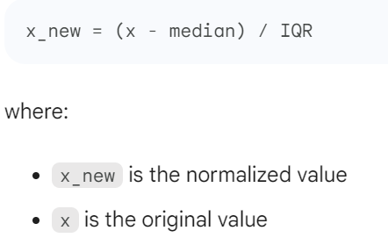
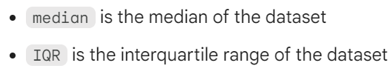
Characteristics of Robust Scaling
The formula for robust scaling is as follows:

Slide 14
Characteristics of Normalizer Scaling
Process: Normalizer scales each data point independently to have a unit norm (L2 norm) or a different norm if specified.
Merits of Normalizer Scaling:
Normalization of Samples: Each data point (sample) is scaled independently, which is useful when handling samples as observations.
Useful in Sparse Data: Particularly beneficial in situations where you have sparse datasets, such as text classification or natural language processing.
Demerits of Normalizer Scaling:
Loss of Feature Relations: As each data point is normalized independently, the relations between features might be affected, potentially altering the relative importance between features.
Influence of Outliers: The method doesn't address the impact of outliers, as it scales each sample independently and might not be suitable for datasets containing outliers.

Slide 15
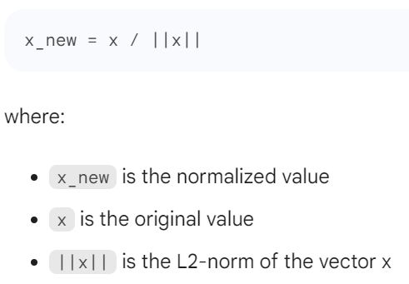
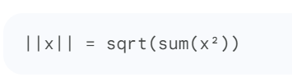
Characteristics of Robust Scaling
The formula for Normalizer Scaling is as follows:
The L2-norm of a vector is the square root of the sum of the squares of its elements. It can be calculated using the following formula:

Slide 16
Standard Scaling Approach - Example
Suppose we have a dataset with the following values for a particular feature:
[10, 20, 30, 40, 50].
Step 1: Calculate the Mean
To start, calculate the mean (average) of the dataset by summing up all the values and dividing by the total number of values.
In this case, the sum is 10 + 20 + 30 + 40 + 50 = 150, and since there are 5 values, the mean is 150/5 = 30.
Step 2: Calculate the Standard Deviation
Next, calculate the standard deviation of the dataset.
The standard deviation measures the spread or dispersion of the data points around the mean. In this case, the standard deviation can be calculated using the formula:
standard deviation = sqrt((sum((x - mean)^2)) / (n - 1))
Where x represents each value in the dataset, mean is the calculated mean from Step 1, and n is the total number of values. Substituting the values into the formula:

Slide 17
Standard Scaling Approach - Example
standard deviation
= sqrt(((10-30)^2 + (20-30)^2 + (30-30)^2 + (40-30)^2 + (50-30)^2) / (5-1))
= sqrt((400 + 100 + 0 + 100 + 400) / 4)
= sqrt(1000 / 4)
= sqrt(250) ≈ 15.81
Step 3: Standardize the Data
Now that we have the mean and the standard deviation, we can standardize each value in the dataset.
To do this, we subtract the mean from each value and divide the result by the standard deviation.
For our example dataset, we can calculate the standardized value for each element:
standardized value = (x - mean) / standard deviation
For the first value (x = 10):
standardized value = (10 - 30) / 15.81
= -20 / 15.81 ≈ -1.27

Slide 18
Standard Scaling Approach - Example
Similarly, we can calculate the standardized values for the remaining elements in the dataset.
So, the standardized dataset for the given example would be approximately [-1.27, -0.63, 0, 0.63, 1.27].
By standardizing the data, we have transformed it into a common scale, making it easier to compare and analyze different variables within the dataset.

Slide 19
MinMax Scaling approach - Example
Let's consider a dataset with the values [10, 20, 30, 40, 50]. We want to scale these values using the MinMax scaling approach.
Step 1: Find the minimum and maximum values in the dataset.
Minimum value = 10
Maximum value = 50
Step 2: Calculate the range of the dataset.
Range = Maximum value - Minimum value = 50 - 10 = 40
Step 3: Apply the MinMax scaling formula to each value in the dataset.
For each value x in the dataset:
Scaled value = (x - Minimum value) / Range
Let's calculate the scaled values using this formula:
For the first value (10):
Scaled value = (10 - 10) / 40 = 0

Slide 20
MinMax Scaling approach - Example
For the second value (20):
Scaled value = (20 - 10) / 40 = 0.25
For the third value (30):
Scaled value = (30 - 10) / 40 = 0.5
For the fourth value (40):
Scaled value = (40 - 10) / 40 = 0.75
For the fifth value (50):
Scaled value = (50 - 10) / 40 = 1
So, the scaled dataset using the MinMax scaling approach is approximately [0, 0.25, 0.5, 0.75, 1].
MinMax scaling transforms the values in the dataset to a specific range, usually between 0 and 1.
This helps in comparing variables with different scales and ensures that all values are within a standardized range.

Slide 21
Robust Scaling approach - Example
Let's go through the Robust Scaling approach using a mathematical example step by step.
Step 1: Consider the dataset [10, 20, 30, 40, 50].
Step 2: Calculate the median of the dataset.
In this case, the median is 30.
Step 3: Subtract the median from each value in the dataset.
This gives us the deviations from the median: [-20, -10, 0, 10, 20].
Step 4: Calculate the absolute value of each deviation. This results in [20, 10, 0, 10, 20].
Step 5: Calculate the median absolute deviation (MAD) by finding the median of the absolute deviations.
In this case, the MAD is 10.
Step 6: Divide each deviation by the MAD.
This gives us the scaled dataset: [-2, -1, 0, 1, 2].

Slide 22
Robust Scaling approach - Example
Robust Scaling is useful when we have outliers in our dataset.
It scales the values based on the median and the MAD, which are resistant to outliers.
This approach ensures that the scaling is not heavily influenced by extreme values and provides a more robust comparison of variables.

Slide 23
Normalizer Scaling approach - Example
Let's go through an example of the Normalizer Scaling approach step by step:
Start with a dataset that contains numerical values.
For this example, let's consider the following dataset:
[2, 4, 6, 8, 10]
Calculate the L2 norm (Euclidean norm) for each data point.
The L2 norm is calculated by summing the squares of each value and then taking the square root.
For our dataset, the L2 norm would be:
sqrt(2^2 + 4^2 + 6^2 + 8^2 + 10^2) = sqrt(4 + 16 + 36 + 64 + 100) = sqrt(220) ≈ 14.83
Divide each data point by the L2 norm.
This step scales each value to have a magnitude of 1.
For our dataset, the normalized values would be:
[2/14.83, 4/14.83, 6/14.83, 8/14.83, 10/14.83] ≈ [0.13, 0.27, 0.40, 0.54, 0.67]

Slide 24
Normalizer Scaling approach - Example
The dataset has now been scaled using the Normalizer Scaling approach.
Each value has been divided by the L2 norm to ensure that the magnitudes are uniform across the dataset.
The Normalizer Scaling approach is useful when you want to scale each data point based on its magnitude relative to the other data points in the dataset.
It ensures that each value has the same scale and allows for meaningful comparisons between variables.
Please note that there are different types of normalizers in data scaling, such as the L1 norm (Manhattan norm) or the max norm.
The steps outlined above are specifically for the L2 norm, but you can apply similar steps for other types of normalizers.

